Slide 1

Hamcrest Matchers and jUnit5
Azat Satklichov
azats@seznam.cz,
http://sahet.net/htm/java.html,
https://github.com/azatsatklichov/java-and-ts-tests/tree/master/javatesting
Notes:
JSLint can be found at http://www.JSLint.com/.
JavaScript statements are composed of: Values, Operators, Expressions, Keywords, and Comments.
JavaScript programs (and JavaScript statements) are often called JavaScript code.
var x, y, z; // Statement 1 x = 5; // Statement 2 y = 6; // Statement 3
var x = 5 * 10; //Statement 4
JavaScript uses the var keyword to declare variables.
An expression is a combination of values, variables, and operators, which computes to a value. E.g. 5 * 10 or x * 10
JavaScript variables are containers for storing data values.
All JavaScript variables must be identified with unique names. JavaScript identifiers are case-sensitive.
Creating a variable in JavaScript is called "declaring" a variable.
var carName;
Difference Between Unicode and UTF-8: Unicode is a character set. UTF-8 is encoding.
Unicode is a list of characters with unique decimal numbers (code points). A = 65, B = 66, C = 67, ....
This list of decimal numbers represent the string “ahello": 97 104 101 108 108 111
Encoding is how these numbers are translated into binary numbers to be stored in a computer:
UTF-8 encoding will store "hello" like this (binary): 01101000 01100101 01101100 01101100 01101111
Encoding translates numbers into binary . Character sets translates characters to numbers.

Slide 2
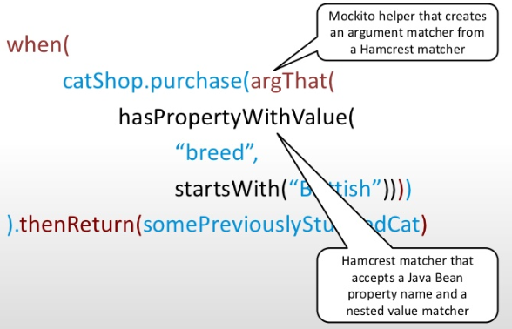
Hamcrest has the target to make tests self-explanatory and easy to read / to make assert statements read like natural language
<!-- objenesis Objenisis: Java already supports this dynamic instantiation of classes using Class.newInstance(). However, this only works if the class has an appropriate constructor. must require a default constructor. Objenesis aims to overcome these restrictions by bypassing the constructor on object instantiation. Needing to instantiate an object without calling the constructor is a fairly specialized task, however there are certain cases when this is useful: -->

Slide 3
Using AssertThat Over Other Assert Methods
1-generation: assert(logical statement), assert(x==y)
2-generation: traditional assert statements: verb, object, and subject (assert equals expected actual) , assertEquals(expected, actual);
3-generation: Hamcrest is typically viewed as a third generation matcher framework.
new syntax, subject, verb, and object (asset that actual is expected)
assertThat(actual, is(equalTo(expected)));
http://hamcrest.org/JavaHamcrest/index
Current version: JavaHamcrest 2.2junit5-uses 2.1, .. , junit4 uses version 1.3,
We use: http://hamcrest.org/JavaHamcrest/javadoc/1.3/

Slide 4
Common Core Matchers
is(T) and is(Matcher<T>), equalTo(T)
not(T) and not(Matcher<T>)
nullValue() and nullValue(Class<T>), notNullValue() and notNullValue(Class<T>)
instanceOf(Class<?>), isA(Class<T> type), sameInstance()
any(Class<T>), allOf(Matcher<? extends T>…) and anyOf(Matcher<? extends T>…)
hasItem(T) and hasItem(Matcher<? extends T>)
hasSize, isIn, , isOneOf, …
Combining matchers
both(Matcher<? extends T>) and either(Matcher<? extends T>)
allOf, anyOf, everyItem, …
String Comparison
containsString, containsStringIgnoringCase, startsWith, endsWithIgnoringCase…

Slide 5
Custom Matchers
TypeSafeMatcher - extend this class to create a cutom matcher .
E.g. onlyDigitsMatcher, perfectNumberMatcher, divsibleBy, RegEx..… COBOL_KEYWORDS,..
public class PerfectNumberMatcher extends TypeSafeMatcher<Integer> { @Override protected boolean matchesSafely(Integer num) { return isPerfectNumber(num); }
@Override public void describeTo(Description description) { description.appendText("only digits"); } }
Combining Matchers, Grouping Matchers, …

Slide 6
Object and Bean Matchers
hasToString - assertThat(processed.getResult().get(0), hasToString("abc "));
typeCompatibleWith - represents an is-a relationship
Bean matchers are very useful to check POJO conditions
hasProperty
samePropertyValuesAs
getPropertyDescriptor, propertyDescriptorsFor

Slide 7
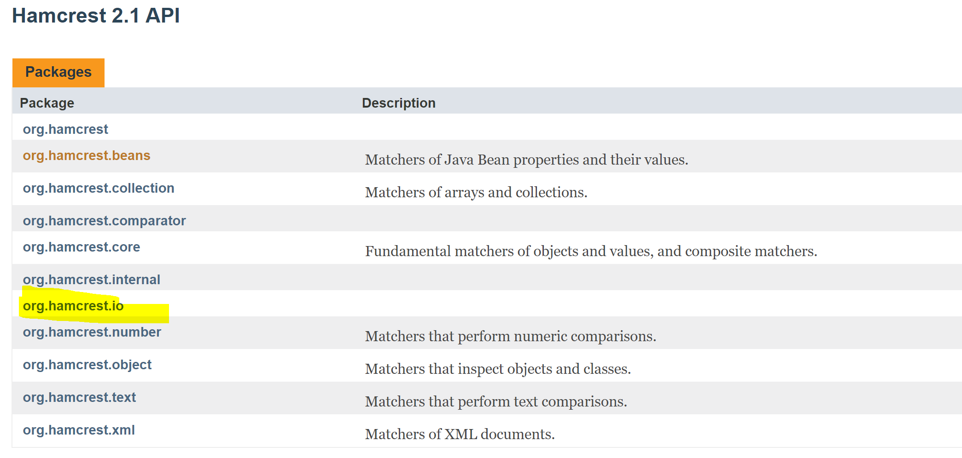
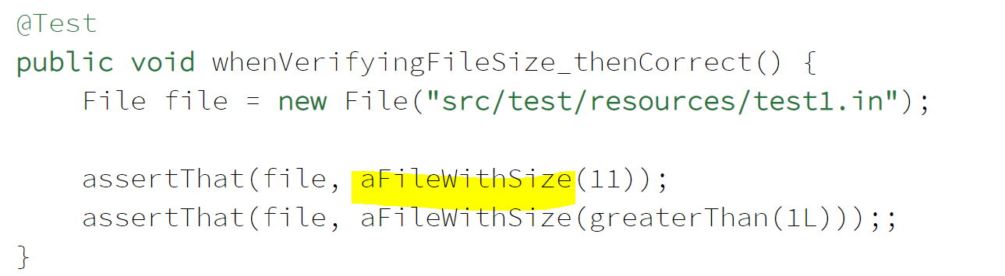
File Matchers
aFileNamed(), aFileWithSize
aWritableFile, aReadableFile,
nExistingDirectory(),
anExistingFileOrDirectory()

Slide 8
Text Matchers
equalToIgnoringCase, equalToIgnoringWhiteSpace
blankString()); blankOrNullString, blankOrNullString()); (NEW Version)
emptyString()); emptyOrNullString, emptyOrNullString()); (NEW Version)
Pattern Matchers (NEW Version) – matchesPattern
Sub-String Matchers -
containsString, containsStringIgnoringCase, stringContainsInOrder, endsWithIgnoringCase,,,

Slide 9
Number Matchers
Proximity Matchers – closeTo (Double, BigDecimal)
Order Matchers - comparesEqualTo, greaterThan, greaterThanOrEqualTo, lessThan, lessThanOrEqualTo
Order Matchers With String Values
Order Matchers With LocalDate Values
Order Matchers With Custom Classes
NaN Matcher - org.hamcrest.number.IsNaN (New version)
assertThat(zero / zero, is(notANumber()));

Slide 10
AssertJ - need ?

Slide 11
Why jUnit 5
jUnit 4 based on Java 7 (can’t use like Java8 lambdas for lazy evaluation, etc), and single jar.
jUnit5, (Sep.2017, runs on Java 8 or >) is more granular (multiple libraries), can import only necessary part. Faster, ..
Consists of three subprojects: JUnit 5 = JUnit Platform + JUnit Jupiter + JUnit Vintage
JUnit Jupiter Engine - module includes new programming and extension models for writing JUnit 5 tests.
Junit Vintage Engine - Supports running JUnit 3 and JUnit 4 based tests on the JUnit 5 platform.
In Junit 4, there is no integration support for 3rd party plugins and IDEs. They have to rely on reflection.
JUnit Platform - dedicated sub-project for integration purpose. It defines the TestEngine API for developing a testing framework that runs on the platform. This module scopes all the extension frameworks we might be interested in test execution, discovery, and reporting.
JUnit 5 can use more than one extension at a time (multiple test runners), which JUnit 4 could not (only one runner at a time). This means you can easily combine the Spring extension with other extensions (such as your own custom extension, life cycle callbacks, param-resolver, ..). e.g. jUnit4, one-runner SpringJUnit4ClassRunner or Parameterized
In Junit 4, @RunWith(Suite.class) and @Suite annotation
In Junit 5, @RunWith(JUnitPlatform.class), @SelectPackages and @SelectClasses
Features for describing, organizing, and executing tests. For instance, tests get better display names and can be organized hierarchically. @DisplayName
https://junit.org/junit5/docs/current/user-guide/, (doesn’t support test suites and parallel execution yet) https://github.com/junit-team/junit5/issues/744, https://github.com/junit-team/junit5/issues/964
https://junit.org/junit5/docs/current/user-guide/#writing-tests-parameterized-tests

Slide 12


jUnit 5 Modules
jUnit 5 Platform
jUnit Jupiter
jUnit Vintage

Slide 13
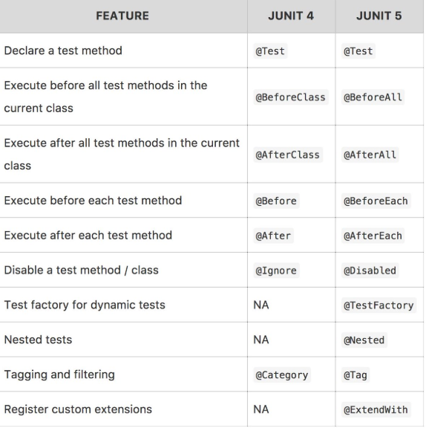
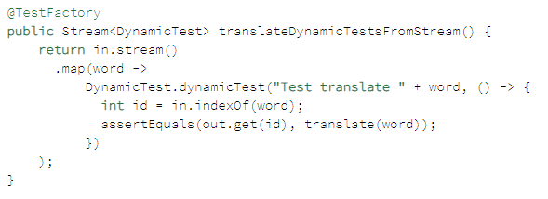
jUnit 5 changes on Annotations
New Features
Display names - @DisplayName
New Assertions
Nested Tests (express relationships on groups of tests)
Parameterized Tests (jUnit4 – Constructor, Field Injection based, @Theory, @DataPoints)
Conditional tests execution - @Disabled @EnabledOnOs, @DisabledOnOs, @EnabledOnJre, @DisabledOnJre, @EnabledIfSystemProperty, @EnabledIf
Test Templates (@TestTemplate, e.g. similar steps )
Meta-annotations (own annotations, Tag..Fast, Prod, ..)
Dynamic Tests - @TestFactory (not @Test, no life-cycle)
@DisplayName(“☀”), @Rule (ErrorCollector to continue execution on failure) @TempDir) and @ClassRule, @ExtendWith, @TempDir
@RepetaedTest(5), @Ex/IncludeTags, @TestInstance [LifeCycle.PER_METHOD (the default). The other is LifeCycle.PER_CLASS]

Slide 14
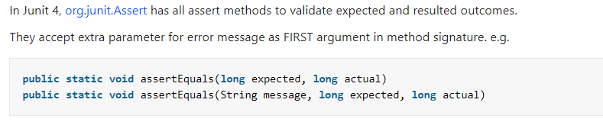
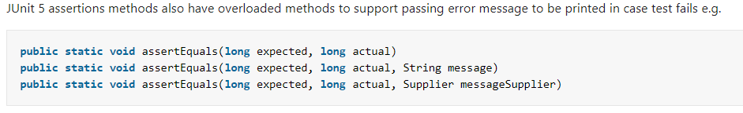
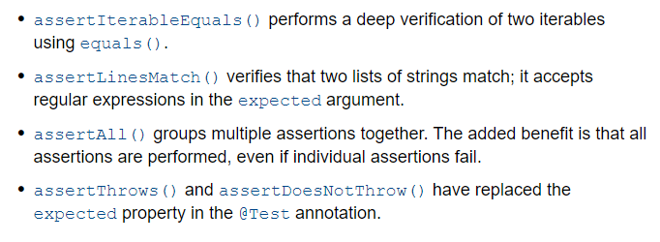
Assertions - to validate expected and actual values
Optional message that an assertion would be printed if it failed is now the last. Also the Supplier (for lazy evaluation)
Group Assertions
jUnit5 New Assertions
@Test public void shouldFailWhenNumbersAreDifferent () {
Assertions.assertTrue(19 == 23,
() -> “Numbers” + 19 + “ and ” + “ are not equal ”);
}
@Test public void shouldAssertAll() {
List<Integer> list = List.of(1, 2, 3);
Assertions.assertAll(“Not ordered list”,
() -> Assertions.assertEquals(list.get(0).intValue(), 1),
() -> Assertions.assertEquals(list.get(1).intValue(), 2),
() -> Assertions.assertEquals(list.get(2).intValue(), 3));
}
To test long running tasks: assertTimeout(),assertTimeoutPreemptively()
For assertTimeoutPreemptively() Executable or ThrowingSupplier will be preemptively aborted if the timeout is exceeded, for assertTimeout() not

Slide 15
jUnit 4 jUnit 5
//multiple runners was problematic, usually required chaining or using an @Rule.
@RunWith(SpringJUnit4ClassRunner.class) public class MyControllerTest {
// ...
}
//JUnit 5, you include the Spring extension instead. @ExtendWith is repetable – multiple extensians can be used
@ExtendWith(SpringExtension.class) class MyControllerTest {
// ...
}
@Test
void shouldRaiseAnException() throws ArithmeticException {
Assertions.assertThrows(ArithmeticException.class, () -> {
//..
});
}
@Test void shouldThrowException() {
Throwable exception = assertThrows(UnsupportedOperationException.class,
() -> {
throw new UnsupportedOperationException("Not supported");
});
assertEquals(exception.getMessage(), "Not supported");
}
@Test(expected = ArithmeticException.class)
void shouldRaiseAnException() throws ArithmeticException {
// ...
}
@Test void shouldThrowException() {
Try {
//code may throw exception
fail(“Not supported");
} catch (UnsupportedOperationException e) {
assertEquals("Not supported“, exception.getMessage());
}
}
@Test
void shouldFailDuetoTimeout() throws InterrptedException {
Assertions.assertTimeout(Duration.ofMillies(10), () -> Thread.sleep(100));
}
@Test(timeout = 10)
void shouldFailDuetoTimeout() throws InterrptedException {
Thread.sleep(100);
}

Slide 16
Assumptions - for stating assumptions about the condition in which a test is meaningful. Assumptions are used whenever it does not make sense to continue execution of a given test method. Don’t result in test failure like assertions. Abort the test (seems like executed but actually test is ignored, watch log).
Junit 4, org.junit.Assume contains methods for stating assumptions:
assumeFalse(), assumeNoException(), assumeNotNull(), assumeThat(), assumeTrue()
@Test public void testNothingInParticular() throws Exception {
Assume.assumeThat("foo", is("bar"));
assertEquals(...);
}
In Junit 5, org.junit.jupiter.api.Assumptions contains methods for stating assumptions: The same assumptions exist, but they now support BooleanSupplier as well as Hamcrest matchers to match conditions
assumeFalse(), assumingThat​(), assumeTrue()
@Test void testNothingInParticular() throws Exception {
Assumptions.assumingThat("foo".equals(" bar"), () -> {
assertEquals(...);
});
}

Slide 17
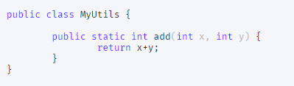
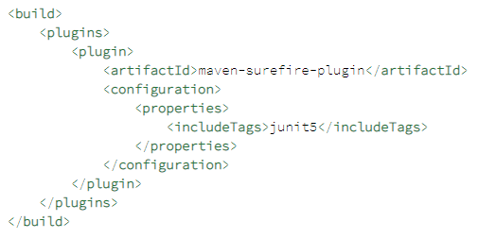
Tagging and Filtering - To group tests jUnit4 was using @Category, replaced with @Tag in jUnit5
Dynamic Tests (JUnit 5 Dynamic tests functionality can be achieved by parameterized tests.)
@Tag("annotations")
@Tag("junit5")
@RunWith(JUnitPlatform.class)public class AnnotationTestExampleTest { /*...*/}
We can include/exclude particular tags using the maven-surefire-plugin:
Junit 4, org.junit.Assume contains methods for stating assumptions:
assumeFalse(), assumeNoException(), assumeNotNull(), assumeThat(), assumeTrue()
@TestFactory Stream<DynamicTest> dynamicTestsExample() {
List<Integer> input1List = Arrays.asList(1,2,3);
List<Integer> input2List = Arrays.asList(10,20,30);
List<DynamicTest> dynamicTests = new ArrayList<>();
for(int i=0; i < input1List.size(); i++) {
int x = input1List.get(i);
int y = input2List.get(i);
DynamicTest dynamicTest =
dynamicTest("Dynamic Test for MyUtils.add("+x+","+y+")",
() ->{assertEquals(x+y,MyUtils.add(x,y));});
dynamicTests.add(dynamicTest);
}
return dynamicTests.stream();
}

Slide 18
jUnit 4 Parameterized Test jUnit 5 Parameterized Test
Or via feeding input-data @Theory, @DataPoint
//JUnit 5 doesn't provide the exact same features than those provided by JUnit 4.
Collection<Object[]> is become Stream<Arguments> that provides more flexibility.
@MethodSource, @ValueSource, @CsvSource, @CsvFileSource, @EnumSource, @argumentsSource
Null and Empty sources: @NullSource, #EmptySource, @NullAndEmptySource,
@ParameterizedTest
@NullSource @EmptySource @ValueSource(strings = { " ", " ", "\t", "\n" })
void nullEmptyAndBlankStrings(String text) {
assertTrue(text == null || text.trim().isEmpty());
}
@Parameters public static Collection<Object[]> data() {
private static Stream<Arguments> data() {
//Example
@RunWith( Parameterized.class )
public class FooInvariantsTest {
@Parameterized.Parameters public static Collection<Object[]> data(){
return new Arrays.asList(
new Object[]{ new CsvFoo() ),
new Object[]{ new SqlFoo() ),
new Object[]{ new XmlFoo() ), );
}
private Foo fooUnderTest; public FooInvariantsTest( Foo fooToTest ){
fooUnderTest = fooToTest;
}
@Test public void testInvariant1(){
...
}
@Test public void testInvariant2(){
...
}
}
//Example
public class FooInvariantsTest {
private static Stream<Argument> data() {
return Stream.of(
Arguments.of(new CsvFoo()),
Arguments.of(new SqlFoo() ));
}
@ParameterizedTest
@MethodSource("data")
public void testInvariant1(){
...
}
@ParameterizedTest
@MethodSource("data")
public void testInvariant2(){
...
}
}

Slide 19
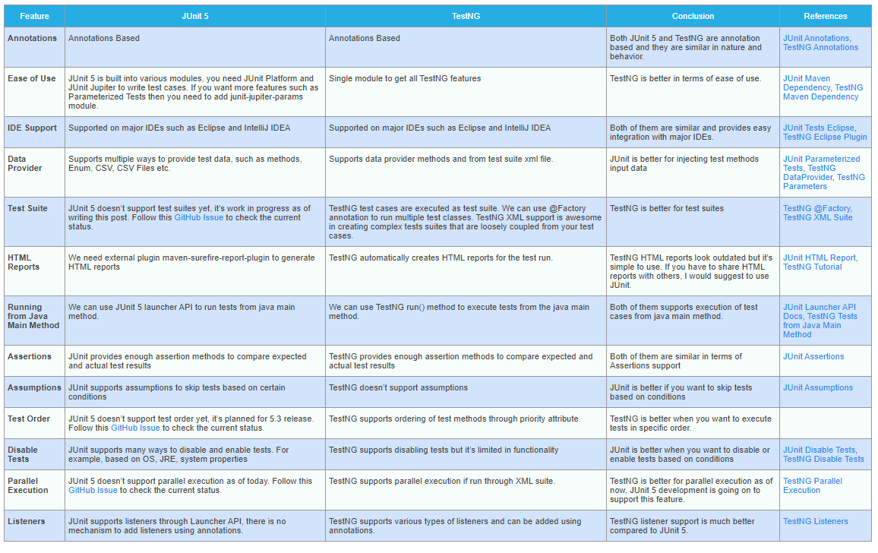
Notes:
JUnit 5 is still evolving and it will have all the missing features in the upcoming releases.
*Assumptions* — testNG has SkipTestException which works like assumptions. Win-win

Slide 20

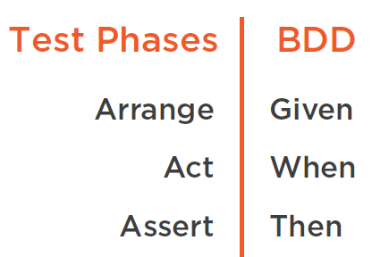
AAA (Arrange -> Act -> Assert) tests, TDD Test Driven Development
https://medium.com/@pjbgf/title-testing-code-ocd-and-the-aaa-pattern-df453975ab80
DDD – Domain Driven Design
BDD – Behavior Driven Development is for UAT (User Acceptance Tests)
An application is specified and designed by describing how it should behave
Given -> when -> Then
https://medium.com/javascript-scene/behavior-driven-development-bdd-and-functional-testing-62084ad7f1f2

Slide 21
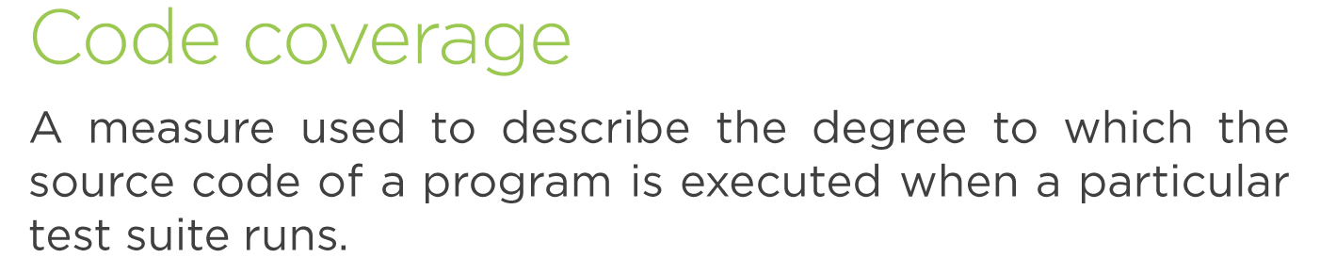
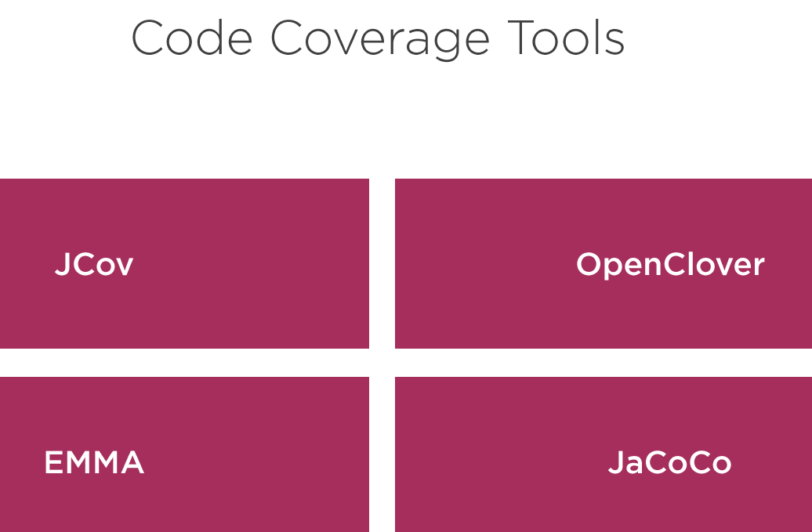

Slide 22
his can be done via using test replacements (test doubles) for the real dependencies. Test doubles can be classified like the following:
A dummy object is passed around but never used, i.e., its methods are never called. Such an object can for example be used to fill the parameter list of a method.
Fake objects have working implementations, but are usually simplified. For example, a memory database is used for testing and not a SQL based database.
A stub class is an partial implementation for an interface or class with the purpose of using an instance of this stub class during testing. Stubs usually don’t respond to anything outside what’s programmed in for the test. Stubs may also record information about calls.
A mock object is a dummy implementation for an interface or a class in which you define the output of certain method calls. Mock objects are configured to perform a certain behavior during a test. They typically record the interaction with the system and tests can validate that.

Slide 23
A test fixture is a fixed state of a set of objects which are used as a baseline for running tests. Another way to describe this is a test precondition.
The percentage of code which is tested by unit tests is typically called test coverage. Jococo, ..
External dependencies should be removed from unit tests, e.g., by replacing the dependency with a test implementation or a (mock) object created by a test framework. Mockito, ..
An integration test aims to test the behavior of a component or the integration between a set of components. Term functional test is sometimes used as synonym for integration test. E2E (protractor, selenium, cypress, ..), ..
Performance tests are used to benchmark software components repeatedly. jMeter, ..
A test is a behavior test (also called interaction test) if it checks if certain methods were called with the correct input parameters. A behavior test does not validate the result of a method call. State testing is about validating the result. Behavior testing is about testing the behavior of the application under test. If you are testing algorithms or system functionality, in most cases you may want to test state and not interactions.

Slide 24

THANK YOU

